Slide 1
SS ZG 526: Distributed Computing
Causal Ordering of Messages
Chittaranjan Hota
Professor, Dept. of Computer Sc. & Information Systems
BITS, Pilani Hyderabad Campus, Hyderabad
hota@hyderabad.bits-pilani.ac.in

Slide 2
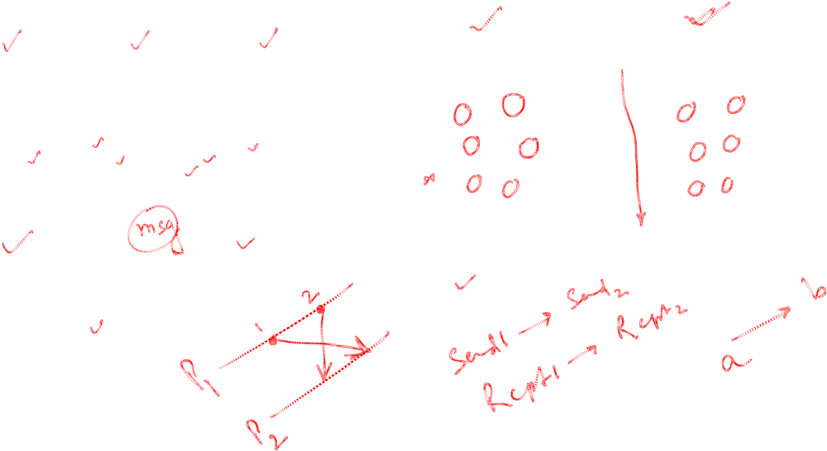
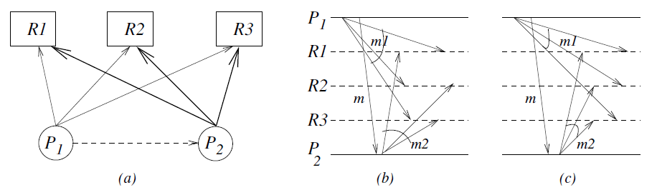
Group communication
Birla Institute of Technology and Science, Pilani (Deemed University)

Slide 3
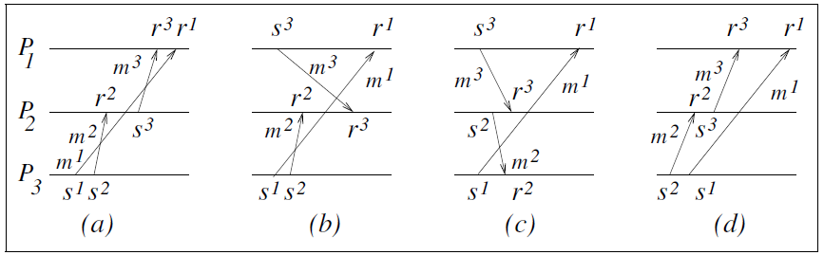
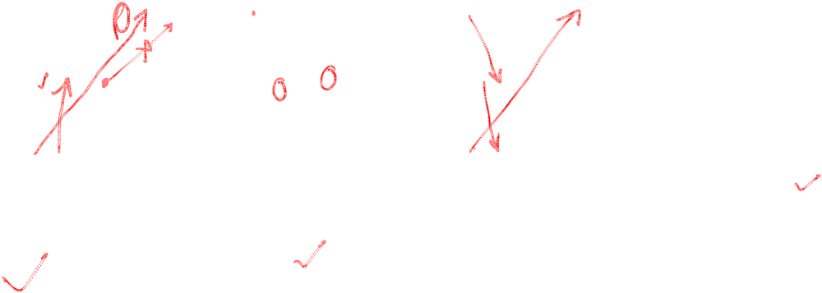
Causal ordering of Messages
Birla Institute of Technology and Science, Pilani (Deemed University)

Slide 4
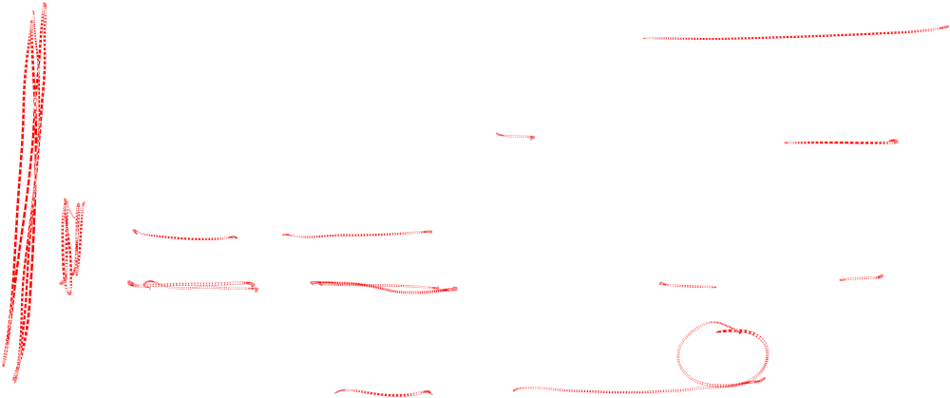
Birman- Schiper- Stephenson (BSS) protocol
Before broadcasting m, process P_{i} increments vector time
VT _{Pi} [i] and timestamps ‘m’.
Process P _{j} ≠ P _{i} receives ‘m’ with timestamp VT _{m} from P_{i} ,
delays delivery until both:
  VT _{Pj} [i] = VT _{m} [i] - 1 // received all previous m’s
  VT _{Pj} [k] >= VT _{m} [k] for every k Є {1,2,…, n} - {i}
  // received all messages also received by P_{i} before sending message ‘m’
When P_{j} delivers ‘m’, VT _{Pj} updated by IR2 of vector clock
SS ZG526, Distributed Computing

Slide 5
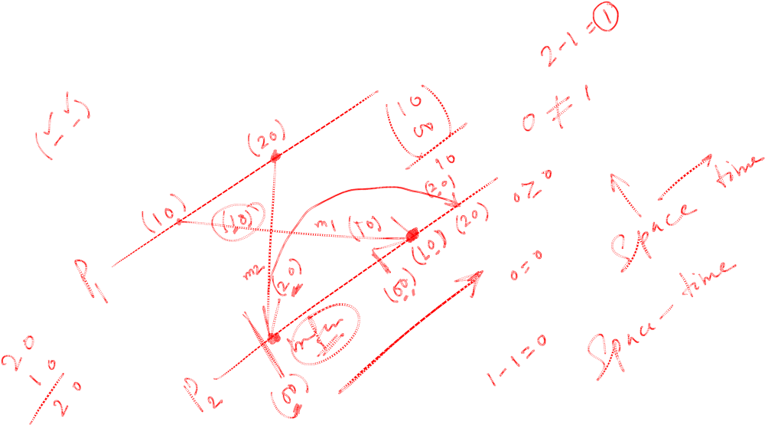
Example1 of BSS

Slide 6
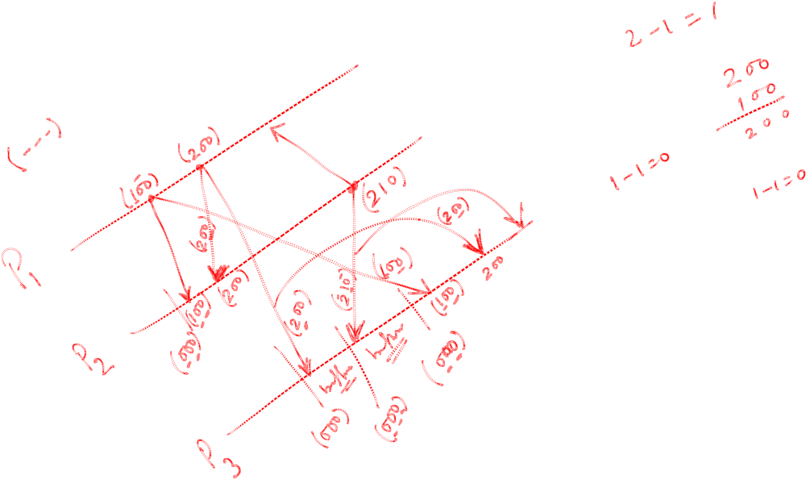
Example2 of BSS

Slide 7
Next session
SES protocol for Causal ordering
Birla Institute of Technology and Science, Pilani (Deemed University)

